Slide 1
Assessment & Treatment of Stuttering in preschool- and school-age children
2024 Iowa Conference on Communicative Disorders- April 12th, 2024
Victoria Tumanova, PhD, CCC-SLP
vtumanov@syr.edu
Image from https://www.sussexbloggers.com/halnaker-windmill-tunnel-of-trees/

Slide 2
Disclosures
Syracuse University employee
Research funding from NIH NIDCD
Topic Area Expert at The Informed SLP
Associate Editor for the Journal of Fluency Disorders
Victoria Tumanova, PhD, CCC-SLP
vtumanov@syr.edu

Slide 3
Objectives
What is stuttering
Facts about stuttering
Spontaneous recovery
Assessment
Establish profile of difficulties and strengths
Tools to use
Perceptions of those who stutter
Setting treatment goals
Treatment for school-age children
Affective
Behavioral
Cognitive
Notes:
Explain stuttering development in early childhood.
Describe risk factors for chronic stuttering for preschool-age children who stutter.
List tools to assess preschool-age child whose caregivers are concerned about stuttering.
Describe affective, behavioral, and cognitive components of stuttering for children.
Explain how to address the affective, behavioral, and cognitive components of stuttering in therapy for school-age children.
Describe how to support and strengthen communication skills for preschool-age and school-age children who stutter.

Slide 4
Stuttering defined by World Health Organization
“Disorder of the rhythm of speech in which the individual knows precisely what she/he wishes to say, but at the time is unable to say it because of an involuntary, repetitive prolongation or cessation of a sound” 1977.

Slide 5
Facts about stuttering
Neurodevelopmental speech disorder
Notes:
Neurodevelopmental speech disorder
Spontaneous recovery facts
Stuttering severity does not correlate with adverse impact

Slide 6
Neurodevelopmental disorders
Neurological disorders with known prenatal cause (genetic or acquired)
Williams syndrome, Fragile X syndrome, fetal alcohol syndrome
Disorders where abnormal neurodevelopment is inferred: actual cause is complex or unknown
Developmental dyslexia
Autism spectrum disorders
Developmental language disorder (Specific language impairment)
Attention deficit +- hyperactivity disorder
STUTTERING
Bishop DVM (2010) Which Neurodevelopmental Disorders Get Researched and Why? PLOS ONE 5(11): e15112. https://doi.org/10.1371/journal.pone.0015112

Slide 7
Facts about stuttering
Stuttering most commonly co-occurs with
Phonological delay
ADHD/ADD

Slide 8
“Spontaneous” Recovery
Simply outgrowing stuttering
Recovery from stuttering without treatment
Estimates of spontaneous recovery range from 32%-80%
Probability of recovery highest from 6-12 months post onset
Majority of children recover within 12-24 months post onset
Yairi & Ambrose (2005)

Slide 9
Clinical Characteristics Associated With Stuttering Persistence: A Meta-Analysis
Children with chronic stuttering
were older at stuttering onset and
exhibited higher frequency of stuttered disfluencies,
lower speech sound accuracy, and
lower expressive and receptive language skills than recovered children,
had a family history of stuttering
Males were also more likely to develop chronic stuttering.
Singer et al. 2020

Slide 10
Healey, Scott Trautman, & Susca (2004). Clinical applications of a multidimensional approach for the assessment and treatment of stuttering. CICSD, 31, 40-48

Slide 11
Indirect treatment
“Indirect” means that the child’s stuttering as well as their general speaking abilities are NOT directly addressed.
The focus is on adjusting the contexts in which communication occurs to facilitate fluency.
This type of therapy typically implemented first for children who are not aware of their stuttering and may be likely to recover from stuttering
These children tend to be very young (2-4 years of age)

Slide 12
Treatment Goals
Speech behaviors targeted for therapy
Aspects of family’s speech and nonspeech behaviors
Fluency goals
Spontaneous fluency
Feelings and attitudes
Work with family’s feelings, behaviors, and attitudes to keep the child feeling positive about speech
Maintenance Procedures
Keep contact with family even after child has achieved fluency; gradually taper off, remaining open to future contact if needed

Slide 13
Indirect therapy
Assess parental models during interactions with their children
Turn taking; pausing, interrupting, eye contact, rate of speech, complexity of child-directed speech/language, frequency of questioning
Parents identify situations/behaviors by child and others that elicit more stuttering
Child’s own speaking patterns are analyzed to focus on stuttering
Parent reduces “time pressure” in daily routine, and “communicative time pressure” in verbal interaction with child

Slide 14
Treatment approaches that use this method
Family-focused treatment
Yaruss, J. S., Coleman, C., & Hammer, D. (2006). Treating preschool children who stutter: Description and preliminary evaluation of a family-focused treatment approach. Language, Speech, and Hearing Services in Schools, 37(2), 118-136.
Demands and Capacities Model treatment
Franken, M. C. J., Kielstra-Van der Schalk, C. J., & Boelens, H. (2005). Experimental treatment of early stuttering: A preliminary study. Journal of Fluency Disorders, 30(3), 189-199.
Palin Parent-Child Interaction Therapy
Millard, S. K., Nicholas, A., & Cook, F. M. (2008). Is parent–child interaction therapy effective in reducing stuttering? Journal of Speech, Language, and Hearing Research, 51(3), 636-650.
Stuttering Prevention and Early Intervention treatment
Gottwald, S. & Starkweather, C. (1995). Fluency intervention for preschoolers and their families. Language, Speech and Hearing Services in Schools, 11, 117-126.

Slide 15
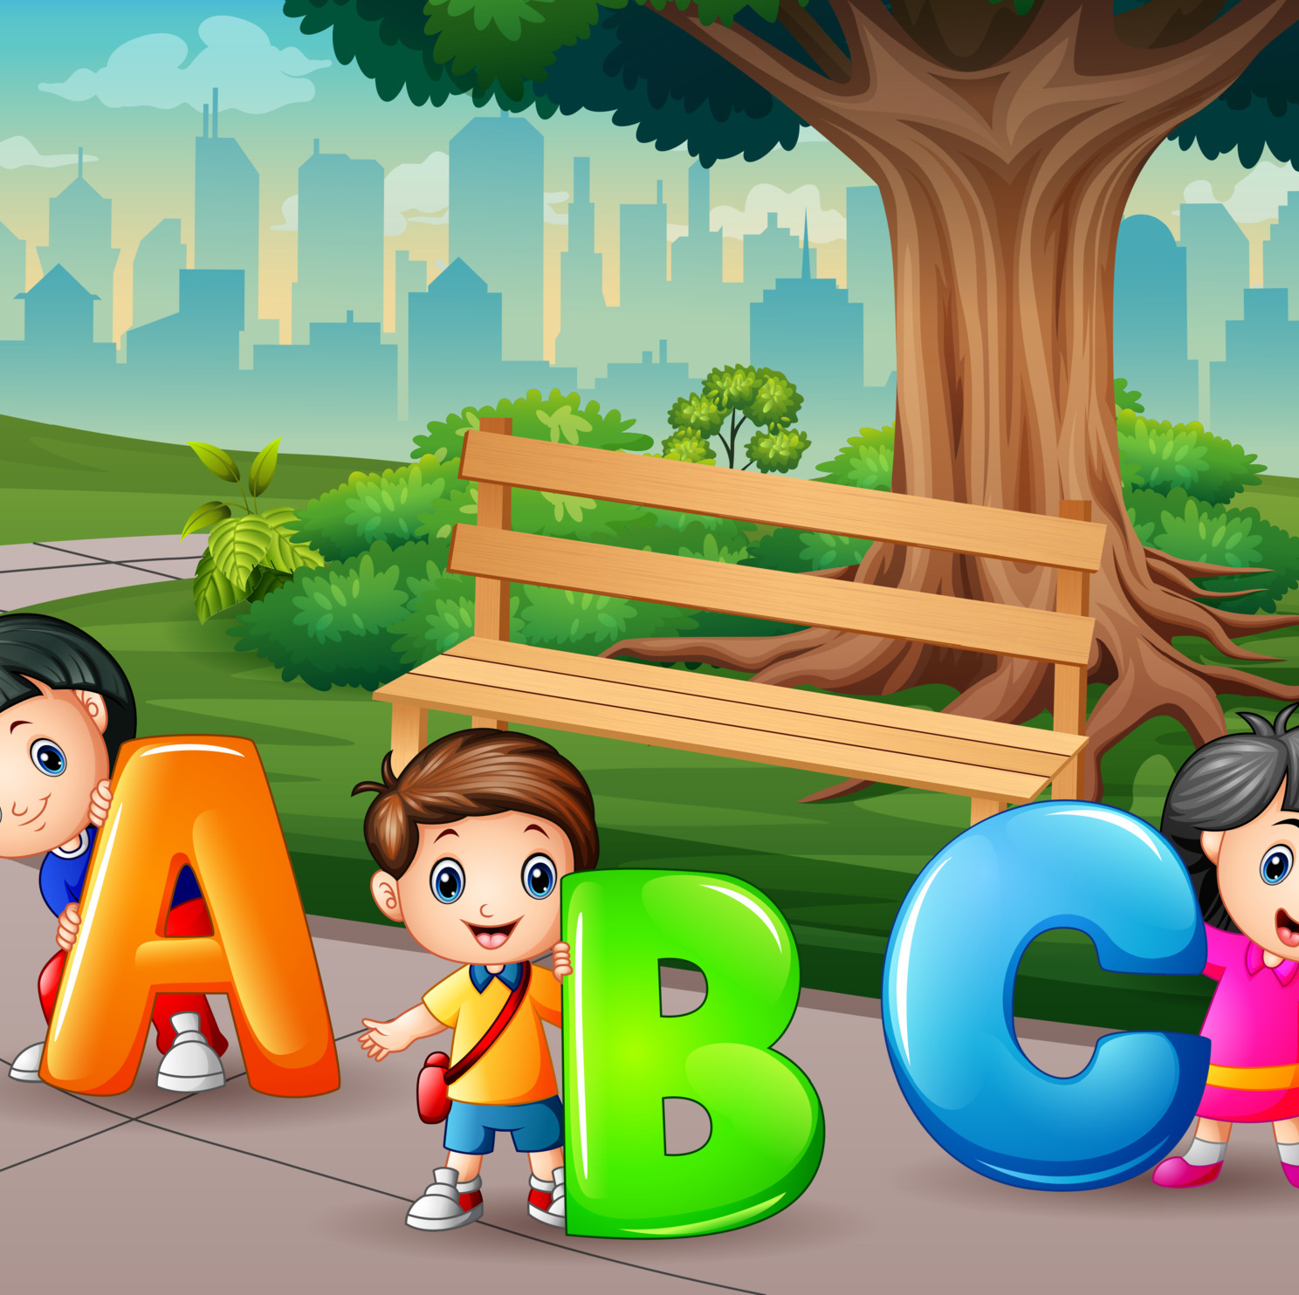
“ABC” of Stuttering
A = Affective
B = Behavioral
C = Cognitive

Slide 16
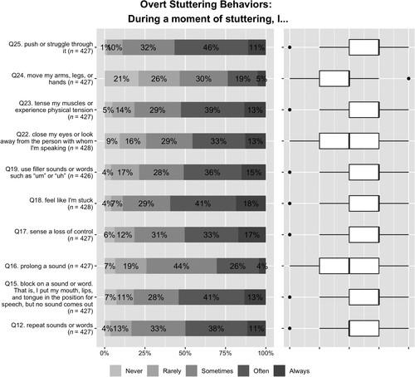
Facts about stuttering: Overt Stuttering Behaviors
Tichenor & Yaruss (2019). Journal of Speech, Language, and Hearing Research, Volume: 62, Issue: 12, Pages: 4335-4350
https://doi.org/10.1044/2019_JSLHR-19-00138

Slide 17
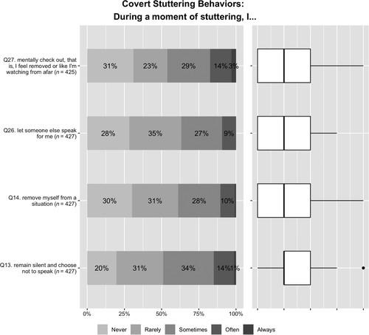
Facts about stuttering: Covert Stuttering Behaviors
Tichenor & Yaruss (2019). Journal of Speech, Language, and Hearing Research, Volume: 62, Issue: 12, Pages: 4335-4350
https://doi.org/10.1044/2019_JSLHR-19-00138

Slide 18
Cognitive-Affective Experiences
Tichenor & Yaruss (2019). Journal of Speech, Language, and Hearing Research, Volume: 62, Issue: 12, Pages: 4335-4350

Slide 19
What is stuttering: perceptions of 502 adults who stutter
Over 90% report that they
repeat sounds or words
block on sounds or words
prolong sounds or words
use filler words “uhm”, “like”
break eye contact
90% push or struggle through
80% tense muscles or experience tension
83% feel embarrassed
70% feel ashamed
76% rarely or never feel empowered
90% feel like I’m stuck
82% sense a loss of control

Slide 20
Anxiety and Stuttering in 7–12 y/o children
The Iverach et al. (2016) study included the largest sample (75 CWS, 150 CWNS)
Compared parent-reported and child-reported scores on the same scale and found that parent mean scores were significantly lower than child mean scores on Spence Children's Anxiety Scale (SCAS) total and subscale scores
The stuttering group had 6-fold increased odds for social anxiety disorder, 7-fold increased odds for subclinical generalized anxiety disorder, and 4-fold increased odds for any anxiety disorder.
24% of stuttering children met criteria for social anxiety disorder
Iverach, L., Jones, M., McLellan, L. F., Lyneham, H. J., Menzies, R. G., Onslow, M., & Rapee, R. M. (2016). Prevalence of anxiety disorders among children who stutter. Journal of Fluency Disorders, 49, 13–28. https://doi.org/10.1016/j.jfludis.2016.07.0021

Slide 21
POlleverywhere
Does trying not to stutter increase fluency?
https://www.polleverywhere.com/multiple_choice_polls/lNyiIZcEGYnIX4kxIg8mH

Slide 22
Take-aways
The behaviors, thoughts, and experiences most commonly reported by speakers who stutter may not be those that are most readily observed by listeners.
Data from this survey suggest that participating in self-help/support groups and having a goal of communicating freely (as opposed to trying not to stutter) are associated with less negative life outcomes due to stuttering.

Slide 23
Stuttering Management: Shared Goals
Thematic network of behaviors associated with “stuttering management” as identified by adolescents who stutter and stuttering specialists.
Outermost boxes represent organizing themes, light gray boxes represent themes that emerged from adolescent interviews,
Dark gray boxes emerged from speech-language pathologist (SLP) interviews,
Striped boxes emerged from both adolescent and SLP interviews.
The second level of boxes represent global themes that comprised the three-part definition of “stuttering management.”
Rogers et al. (2021). American Journal of Speech-Language Pathology, Volume: 30, Issue: 6, Pages: 2492-2509, https://doi.org/10.1044/2021_AJSLP-20-00186

Slide 24
B
Learning and Using Strategies for speaking more fluently and/or stuttering with less tension and struggle
Stuttering Management
GOALS
A
C
Saying what you want to say without avoiding sounds/words/situations
Changing negative thoughts and feelings about stuttering

Slide 25
Affective
Affective component includes helping a child who stutters:
be an effective communicator,
feel confident about their ability to speak,
and approach various speaking situations rather than avoid them

Slide 26
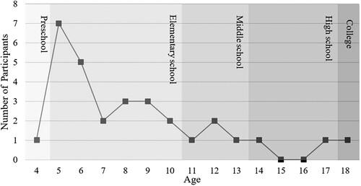
Concealing Stuttering at School
Concealing Stuttering at School: “When You Can't Fix It…the Only Alternative Is to Hide It”
Age of concealment according to self-report in adults who stutter
Gerlach-Houck, Kubart & Cage, Language, Speech, and Hearing Services in Schools, Volume: 54, Issue: 1, Pages: 96-113, https://doi.org/10.1044/2022_LSHSS-22-00029

Slide 28
Reducing Fear and Avoidance
Help child learn that feeling fear and making mistakes are OK
Lots of practice on feared sounds, words, and situations
Help child find support in other children who stutter or friends; role play
Being Open about Stuttering
Help child develop casual comments about his stuttering
Help child talk to teachers and classmates about stuttering

Slide 29
Disclosure
What is it?
Child chooses to openly acknowledges own stuttering to listeners
Why use it?
Allows the child to take control of the situation
It promotes openness about using techniques
Helps listeners know what to expect
Informs listeners what the client wants them to do
When to use it?
Like other tools, it should occur in a hierarchy (e.g., family, friends, group therapy, teachers/co-workers, strangers)
At the beginning of a conversation or presentation

Slide 30
Addressing Teasing and Bullying
(a) educate the child and others in their environment (e.g., teachers, peers, and parents) about bullying so they would understand the reasons children are bullied and learn techniques that help to reduce bullying,
(b) help the child learn and practice appropriate responses that minimize bullying, and
(c) reduce the likelihood that their classmates would engage in bullying behaviors, through self-disclosure about stuttering and education about both stuttering and bullying.
Murphy, Yaruss, Quesal, (2007). Journal of Fluency Disorders, 32

Slide 31
OASES
Overall Assessment of the Speaker's Experience of Stuttering (OASES™)
OASES Response Forms have been developed and validated, with age-appropriate items and instructions for 3 age groups:
OASES-S: School-Age Children (ages 7-12; 60 items)
OASES-T: Teens (ages 13-17; 80 items)
OASES-A: Adults (ages 18 and above; 100 items)
Notes:
Overall Assessment of the Speaker's Experience of Stuttering (OASES™)

Slide 32
OASES
4 sections, each on a 5-point scale
Sections are closely related to the ICF Model
Section I: General Information about Stuttering
Speaker’s perception of the Impairment and general knowledge and perception of the stuttering disorder
Section II: Affective, Behavioral, Cognitive Reactions
Section III: Communication in Daily Situations
Activity Limitation / Environmental Factors
Section IV: Impact of Stuttering on Quality of Life
Participation Restriction / Environmental Factors

Slide 33
Cognitive
Cognitive component includes
educating the child about the nature of speaking and stuttering,
discovering what they do when they speak fluently and when they stutter
Preparing them for various communicative contexts and
Help them feel empowered to communicate.

Slide 34
Cognitive Component
Awareness and understanding of stuttering
Is client aware that he/she stutters
Child’s thoughts and beliefs about why he/she stutters
Why do you stutter – client’s theory
Can client identify moments of stuttering
How do you stutter – describe/show the SLP
Child’s awareness of anything he/she does to help
What are child’s attitudes about speaking?
Child’s level of worry or distress
Child’s perception of parents’ worry and distress
Theory of therapeutic change

Slide 35
Behavioral
The behavioral component includes:
working on the child’s speech behaviors and
helping them control their speech and
speak with ease rather than with tension and struggle.

Slide 36
Making Speech Change
Exploring Talking and Stuttering
Changing Talking
Changing Stuttering
Choosing Tools: What and When

Slide 37
Exploring Talking
In order to understand and feel what he/she does during stuttering, the child must know how we talk
Establishes common terminology between child and clinician
Develops understanding of how we coordinate respiration, phonation & articulation for speech (i.e. “speech helpers”)
Reinforces that his/her speech system is “normal”; NOTHING NEEDS TO BE ‘FIXED’
Starting treatment in a way that is removed from emotion: neutral and objective

Slide 38
Normal Talking Approach
Developed by Dean Williams
CWS and their SLP need to adopt a scientific, descriptive approach to talking about speaking and stuttering
Change in the thinking process/pattern is a major part of therapy
Five Parameters of Forward Moving Speech
Airflow
Movement
Timing/rate
Sound/voicing
Tensing/pressure

Slide 39
Exploring Stuttering: How do you stutter?
Identify aspects of stuttering
In order to change behavior, need to know when and what to change
Exploring stuttering ties information from exploring talking to child’s own behavior/speech patterns
Explore how “speech helpers” work in fluency
Explore what happens in stuttering
Holding onto stutters and feeling what is happening
Desensitizing

Slide 40
Tools For Change
Changing Talking
Changing rate
Soft starts/easy onsets/light contacts
Changing Stuttering
Voluntary stuttering
Holding & tolerating a moment of stuttering
In-block corrections/pullouts
Post-block corrections/cancellations

Slide 41
Changing Talking Changing Rate
What is it?
Slower speech overall: fewer syllables or words per minute
Should sound smooth and connected, not choppy
Why use it?
It’s fluency enhancing because it…
Helps child attend to what he/she is doing
Gives more time to process
Gives child time to make changes in complex motor coordination
Helps child feel changes in muscle tension
How can rate be changed?
Stretching sounds or syllables
Phrasing and pausing
Combining stretches with phrasing/pausing

Slide 42
Changing Talking Soft Starts/Easy Onset and Light Contacts
What are they?
Slower, physically relaxed speech initiation
Decreased muscle tension and less tense articulatory constriction (e.g. bilabial closure, tongue-alveolar contact)
Why use them?
Help initiate smooth airflow, voicing, and physically relaxed, smooth articulator movement
When to use them?
Beginning of phrases or utterances
Phrase boundaries

Slide 43
Teaching Fluency Skills: Superfluency
Specific fluency skills
Flexible rate
Pausing
Easy onsets
Light contacts
Proprioception
Combine all into “superfluency”
Replace stuttering with “Superfluency”
Practice “superfluency” with three-word sentences
Practice long and short sentences beginning with various sounds
Practice in conversation with clinician modeling

Slide 44
Changing Stuttering: Deliberate (or Voluntary) Stuttering
What is it?
The child stutters “on purpose”, choosing when and how
Why use it?
Can be used to teach any aspect of changing and varying stuttering
Assists in building awareness of stuttering moments
Decreases fear and avoidance of stuttering
Desensitizes to listener reactions
Creates a feeling of confidence in the ability to say feared words
Confront what might otherwise be avoided
When and how to use it?
Prelude to using “pullouts”
Begin teaching at the single word level with unfeared sounds or words
Begin using it in unfeared situations
Build to use on feared words or in feared situations
Notes:
Ben and the phone call

Slide 45
Changing Stuttering: Holding & Tolerating A Moment of Stuttering
What is it?
Staying in a moment of stuttering
Child continues speech “movement” rather than stopping, “backing up”, or otherwise using “reactive” speech strategies
Why use it?
Increases child’s awareness of what he/she is doing during the stuttering moment
Helps reduce avoidances
Is desensitizing
When and how to use it?
After child can identify when and how he/she is stuttering
Clinician has to be supportive and encouraging as the child is holding the stuttering moment

Slide 46
Changing Stuttering: Pullout
What is it?
Why use it?
“Holding on” to the stuttering moment and “staying with it”
Helps to focus in on site of physical tension and cessation of movement so as to
Change the stuttering moment through reducing or “easing off” tension and slowly moving ahead into the next sound or word
Confront the stuttering moment and “take charge” (desensitization)
Release tension and keep speech moving forward
Reinforce a looser or “easier” way of stuttering

Slide 47
Changing Stuttering: Pullout
When and how to use it?
When the child experiences a high degree of emotionality or feels “stuck” in a moment of stuttering
After the child has learned to “hold onto” a moment of stuttering and tolerate it
Start with deliberate or “fake” stuttering at the single word level

Slide 48
Changing Stuttering: Cancellation
What is it?
Finishing a stuttered word then
Pausing for a moment to plan (e.g. pantomime or silently revisit the word) then
Stuttering on the word again in an easier way
Why use it?
The child learns to “cancel out” or replace hard stuttering with a looser, more controlled form of stuttering
Cancellation discourages avoidance behaviors such as recoiling, changing words, stopping in a block and backing up
Cancellation reinforces easier stuttering and build confidence

Slide 49
Changing Stuttering: Cancellation
When and how to use it?
Child MUST complete the hard stutter before pausing and making it easier
If the child is unable to pullout or missed the opportunity to use a pullout, this will provide another opportunity to learn to stutter more easily and build confidence
Typically used in the therapy room only as a way of learning a strategy, not in the outside world

Slide 50
Advocating for CWS in Public School Settings
Consider the impact of child’s stuttering on education including extracurricular activities
Does student participate fully in school activities, or does stuttering limit him or her? (Consider using TASCC to assess student’s communication abilities in class)
Can student meet school’s curriculum objectives, especially those related to speaking?
Ribbler (2006). When a student stutters: Identifying the adverse educational impact. Perspectives on Fluency Disorders.
“Stuttering can affect all areas of academic competency, including academic learning, social-emotional functioning, and independent functioning"
Stuttering, however, do not necessarily affect test scores or subject grades.

Slide 51
From Ribbler (2006). When a student stutters: Identifying the adverse educational impact. Perspectives on Fluency Disorders.

Slide 52
School-age children: Resources
http://say.org/camp/about/
http://www.friendswhostutter.org/mentoring-program/
http://www.friendswhostutter.org/one-day-conferences/

Slide 53
The 3Es therapy planning tool
Education
Ease
Gore, K., & Luckman Margulis, C. (2022). 3Es: An all-inclusive stuttering therapy tool. Perspectives of the ASHA Special Interest Groups, 7(3), 716-727.
Empowerment

Slide 54
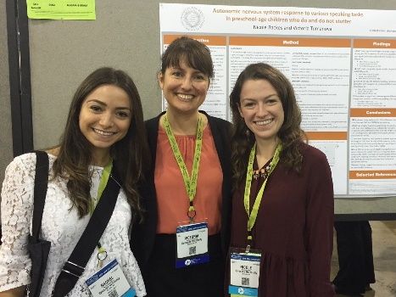
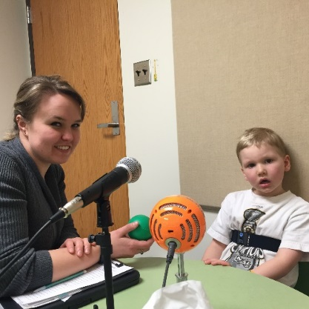
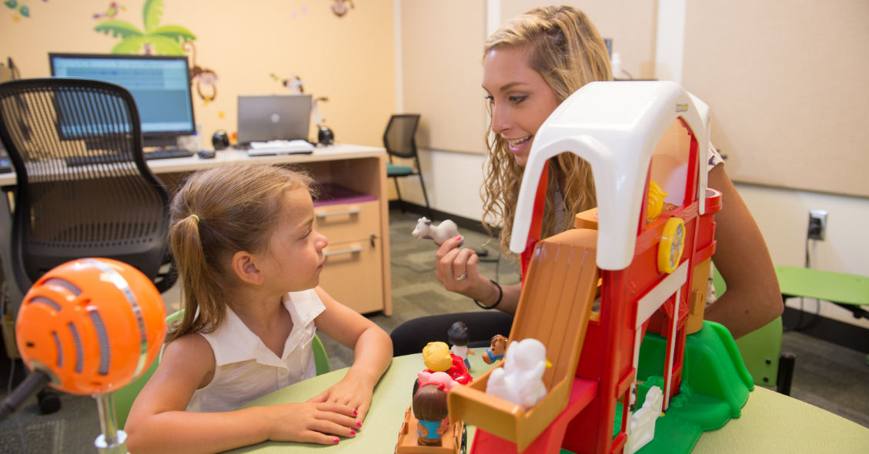
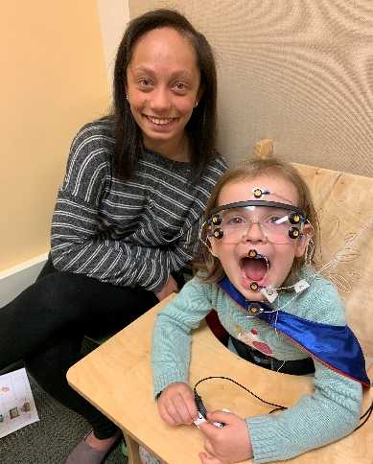
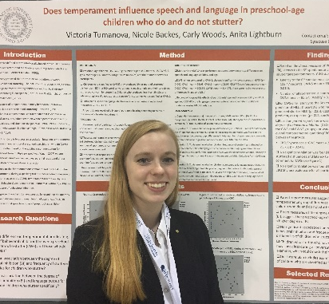
Stuttering Research Lab at Syracuse U
https://stuttering.syr.edu/
Currently inviting preschoolers who stutter (3-6 y/o) and their parents
Email: stuttering@syr.edu
Notes:
Stuttering in some children develops when motor control and coordination for speech is delayed or deficient compared to language processing skills or demands
Emotional responses can exacerbate stuttering

